Slide 2
STRONG

Slide 3
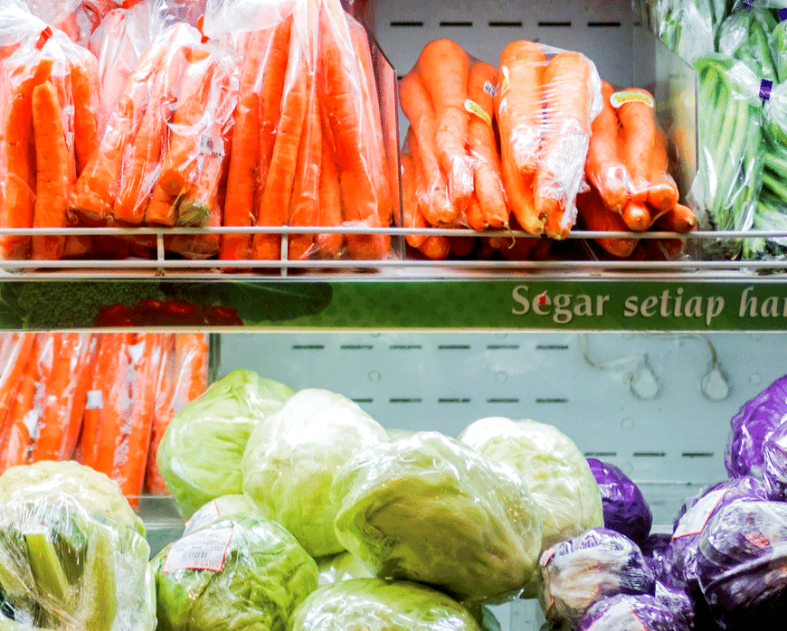
STRONG | FLEXIBLE

Slide 4
STRONG | FLEXIBLE | LONG-LASTING

Slide 5
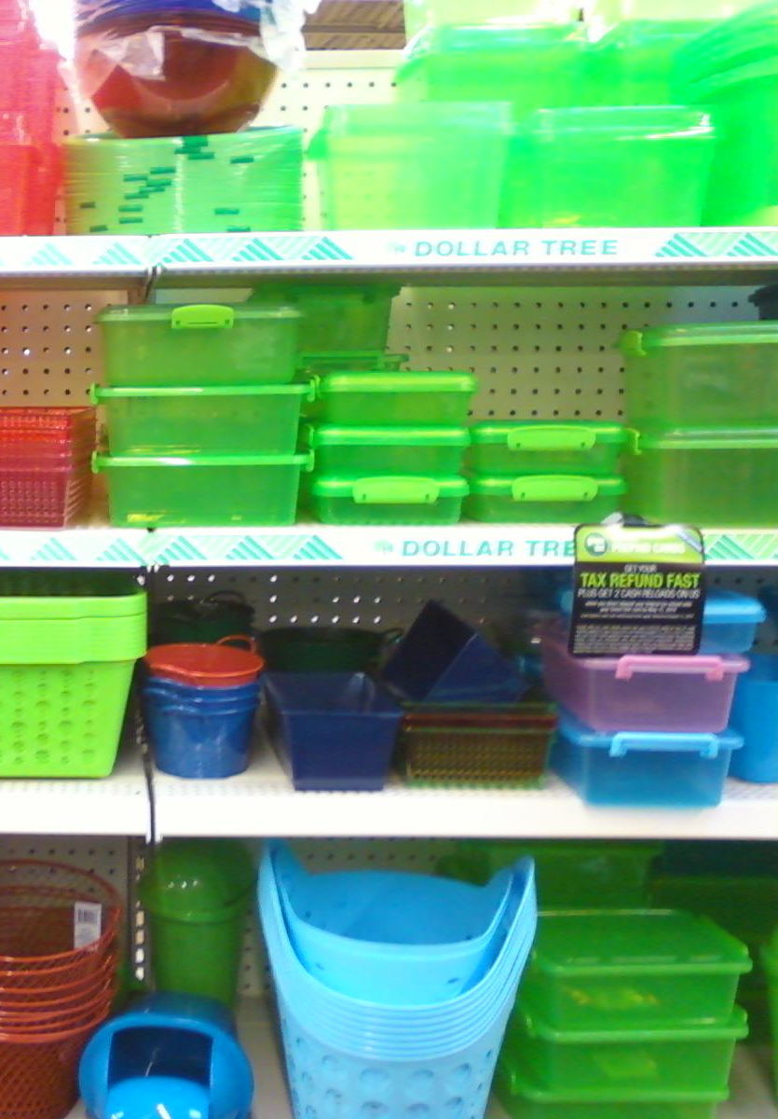
STRONG | FLEXIBLE | LONG-LASTING | INEXPENSIVE

Slide 6
STRONG | FLEXIBLE | LONG-LASTING | INEXPENSIVE | STERILE

Slide 11
SINGLE-USE PLASTIC

Slide 18
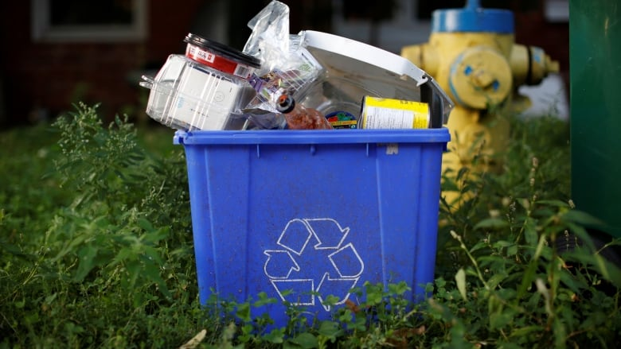

Slide 19
9%

Slide 20
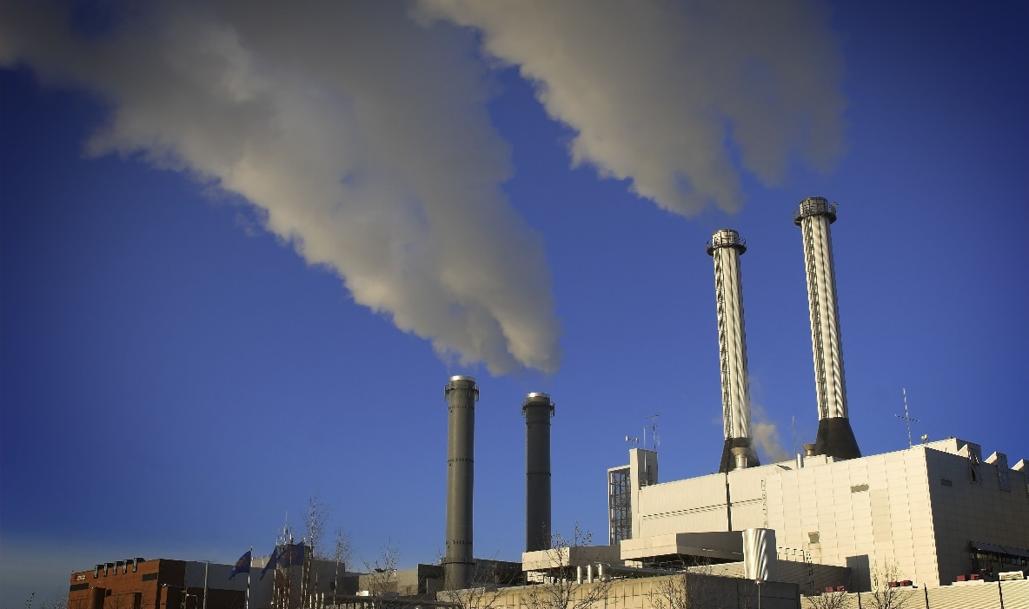
9%

Slide 21
9%
12%

Slide 22
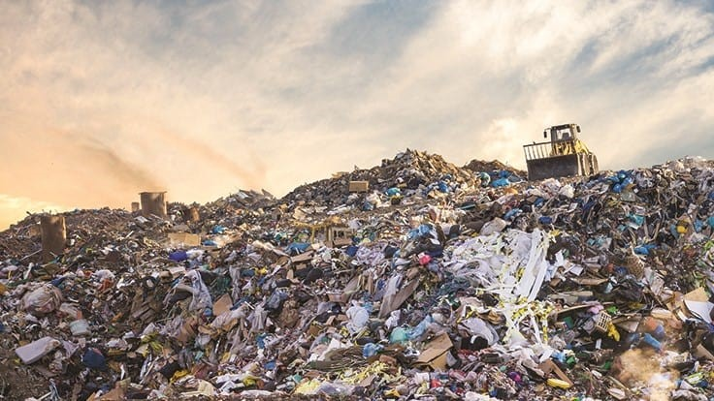
9%
12%

Slide 23
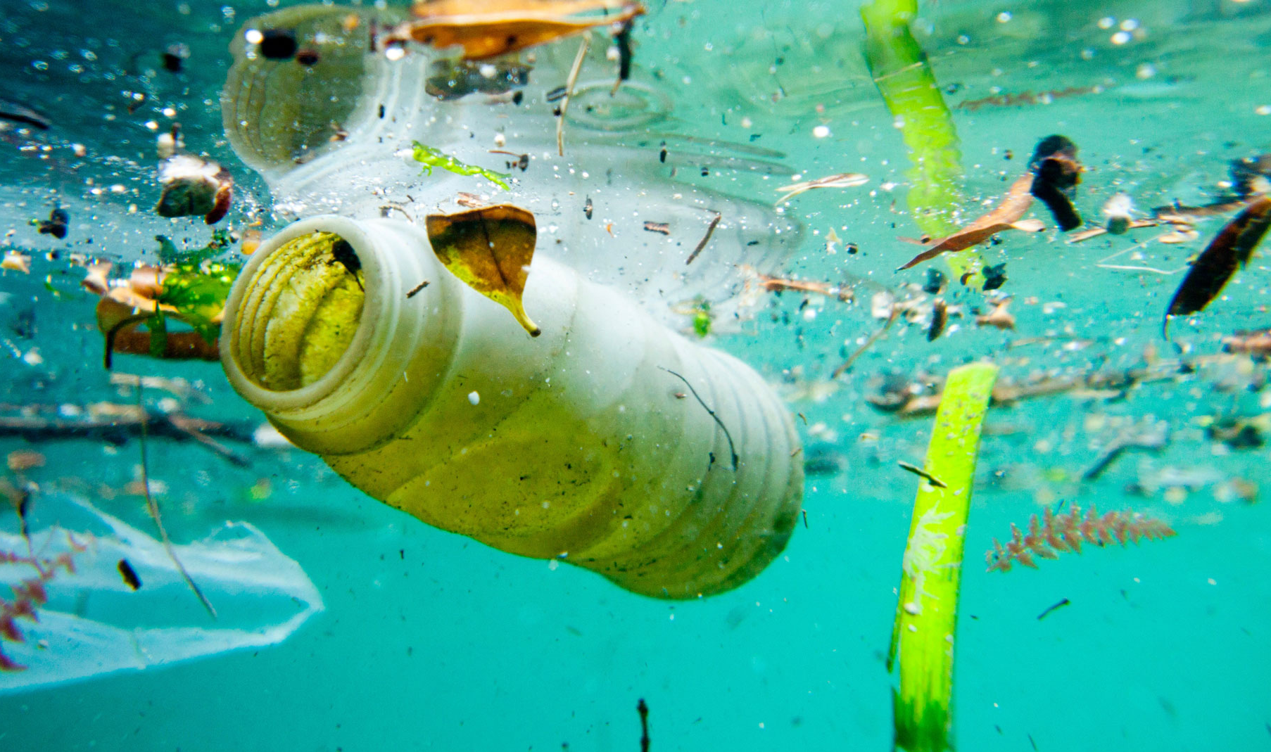
9%
12%

Slide 24
9%
79%
12%

Slide 25
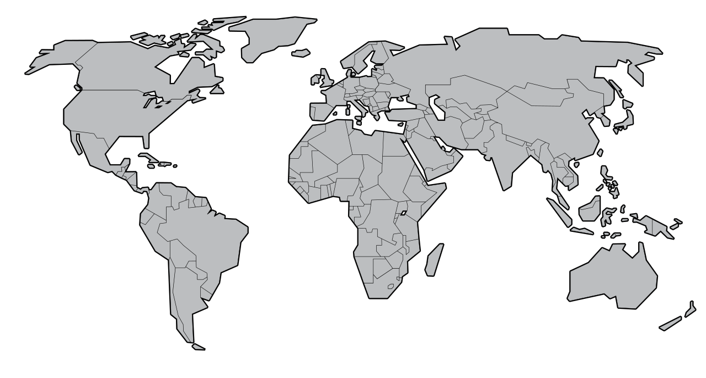
Notes:
One of the big problems with plastic pollution is it travels all over the place! For example if I were to throw a small plastic rubber duckie into Lake Ontario, It might end up travelling all the way to England
That sounds pretty unlikely, but to explain how

Slide 26
Notes:
One of the big problems with plastic pollution is it travels all over the place! For example if I were to throw a small plastic rubber duckie into Lake Ontario, It might end up travelling all the way to England
That sounds pretty unlikely, but to explain how

Slide 27
Notes:
One of the big problems with plastic pollution is it travels all over the place! For example if I were to throw a small plastic rubber duckie into Lake Ontario, It might end up travelling all the way to England
That sounds pretty unlikely, but to explain how

Slide 28
Notes:
One of the big problems with plastic pollution is it travels all over the place! For example if I were to throw a small plastic rubber duckie into Lake Ontario, It might end up travelling all the way to England
That sounds pretty unlikely, but to explain how

Slide 29
Notes:
One of the big problems with plastic pollution is it travels all over the place! For example if I were to throw a small plastic rubber duckie into Lake Ontario, It might end up travelling all the way to England
That sounds pretty unlikely, but to explain how

Slide 31
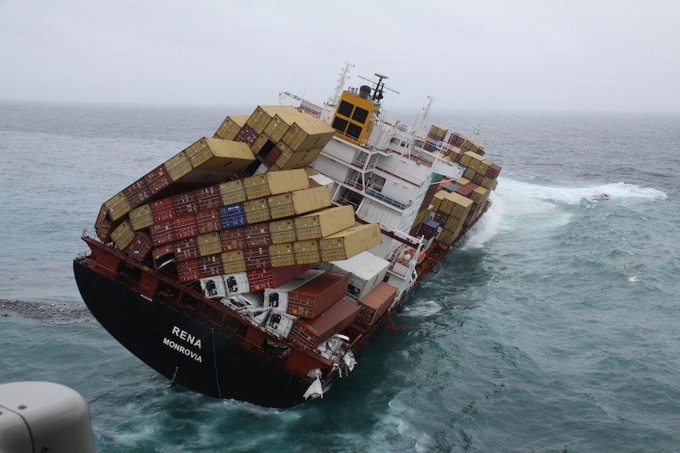
350 shipping containers lost each year

Slide 32
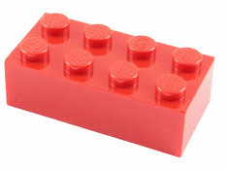
350 shipping containers lost each year
3 million LEGO

Slide 33
350 shipping containers lost each year
3 million LEGO
34,000
hockey gloves

Slide 34
350 shipping containers lost each year
3 million LEGO
34,000
hockey gloves
50,000 Nike Shoes

Slide 35
28,000
bathtub
toys
350 shipping containers lost each year
3 million LEGO
34,000
hockey gloves
50,000 Nike Shoes

Slide 37
Lesson Topic Ideas
Buoyancy
Ocean gyres
Drift ice
Ice floes
Shipping containers
How goods travel
Exports
Imports
Design

Slide 39
HOW DOES PLASTIC HARM LIFE?

Slide 40
Entanglement
Notes:
So all that plastic waste on the beach, it doesn’t look great – but how does plastic exactly harm plant and animal life?

Slide 41
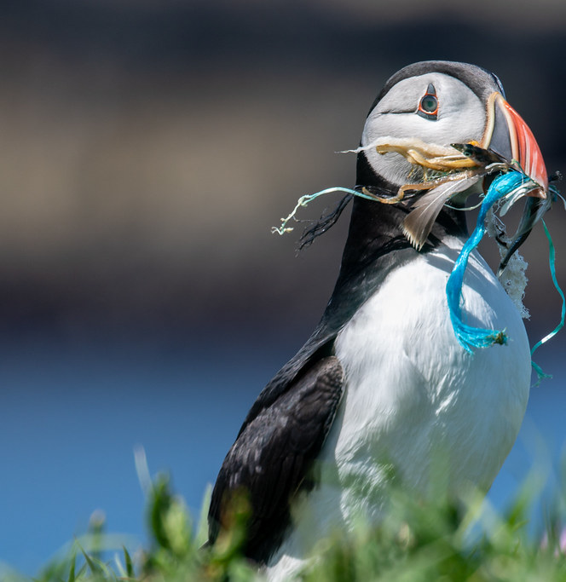
Entanglement
Ingestion
Notes:
So all that plastic waste on the beach, it doesn’t look great – but how does plastic exactly harm plant and animal life?

Slide 42
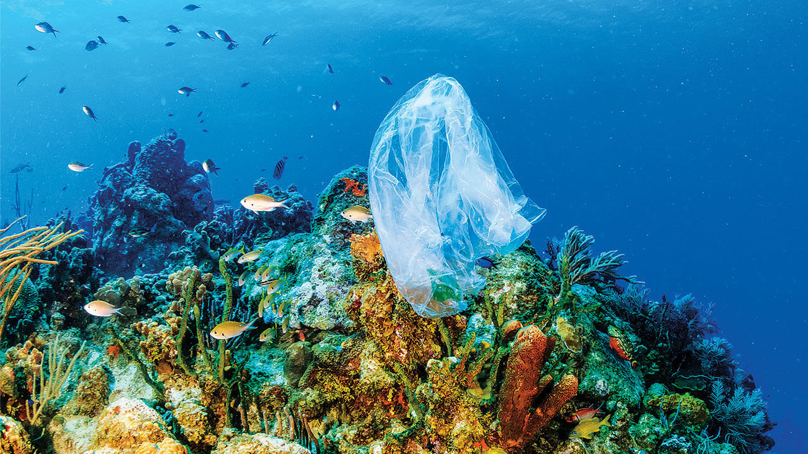
Entanglement
Ingestion
Toxicity
Notes:
So all that plastic waste on the beach, it doesn’t look great – but how does plastic exactly harm plant and animal life?

Slide 43
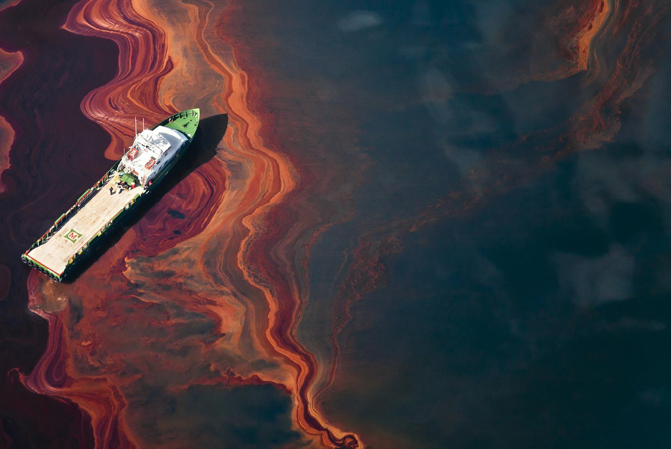
Entanglement
Ingestion
Toxicity
Production Pollution
Notes:
So all that plastic waste on the beach, it doesn’t look great – but how does plastic exactly harm plant and animal life?

Slide 44
99%
Entanglement
Ingestion
Toxicity
Production Pollution
Notes:
So all that plastic waste on the beach, it doesn’t look great – but how does plastic exactly harm plant and animal life?

Slide 46
YOUR CONTRIBUTIONS CAN MAKE A DIFFERENCE!

Slide 47
1) EVERY PIECE COUNTS

Slide 48
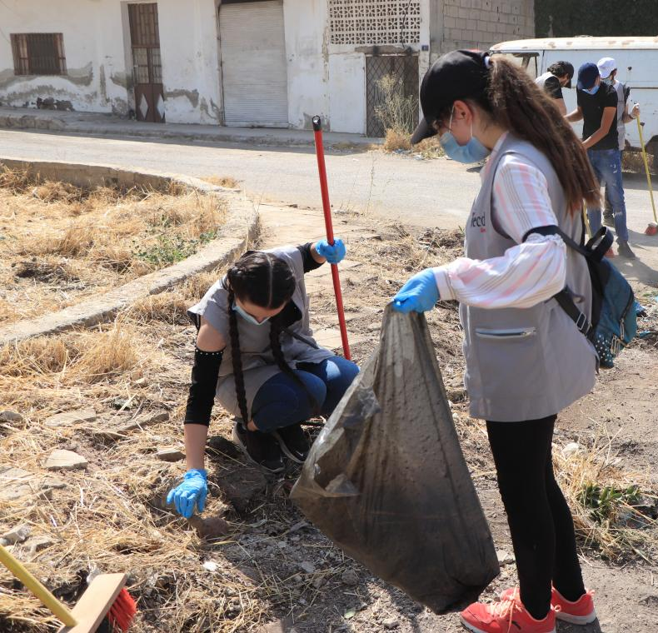
1) EVERY PIECE COUNTS

Slide 49
1) EVERY PIECE COUNTS

Slide 50
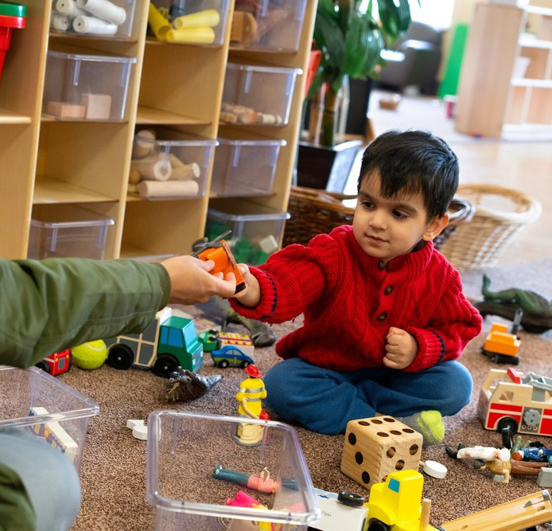
1) EVERY PIECE COUNTS

Slide 51
2) YOUR CONTRIBUTIONS STACK UP OVER TIME

Slide 52
2) YOUR CONTRIBUTIONS STACK UP OVER TIME

Slide 53
2) YOUR CONTRIBUTIONS STACK UP OVER TIME

Slide 54
2) YOUR CONTRIBUTIONS STACK UP OVER TIME

Slide 55
3) PEOPLE CARE ABOUT POLLUTION

Slide 56
3) PEOPLE CARE ABOUT POLLUTION

Slide 57
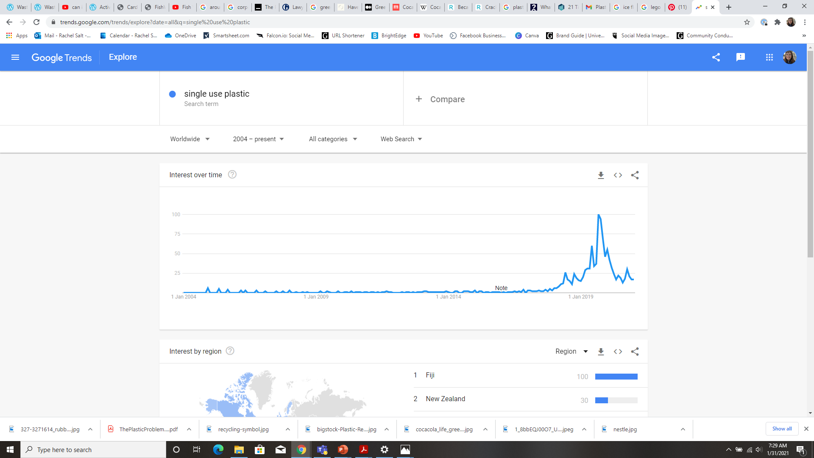
3) PEOPLE CARE ABOUT POLLUTION

Slide 58
3) PEOPLE CARE ABOUT POLLUTION

Slide 59
3) PEOPLE CARE ABOUT POLLUTION

Slide 60
3) PEOPLE CARE ABOUT POLLUTION

Slide 61
3) PEOPLE CARE ABOUT POLLUTION
September 2019

Slide 62
3) PEOPLE CARE ABOUT POLLUTION
September 2019

Slide 63
3) PEOPLE CARE ABOUT POLLUTION
September 2019
15 Years

Slide 64
4) THERE ARE SOLUTIONS, AND YOU CAN BE PART OF THEM!

Slide 65
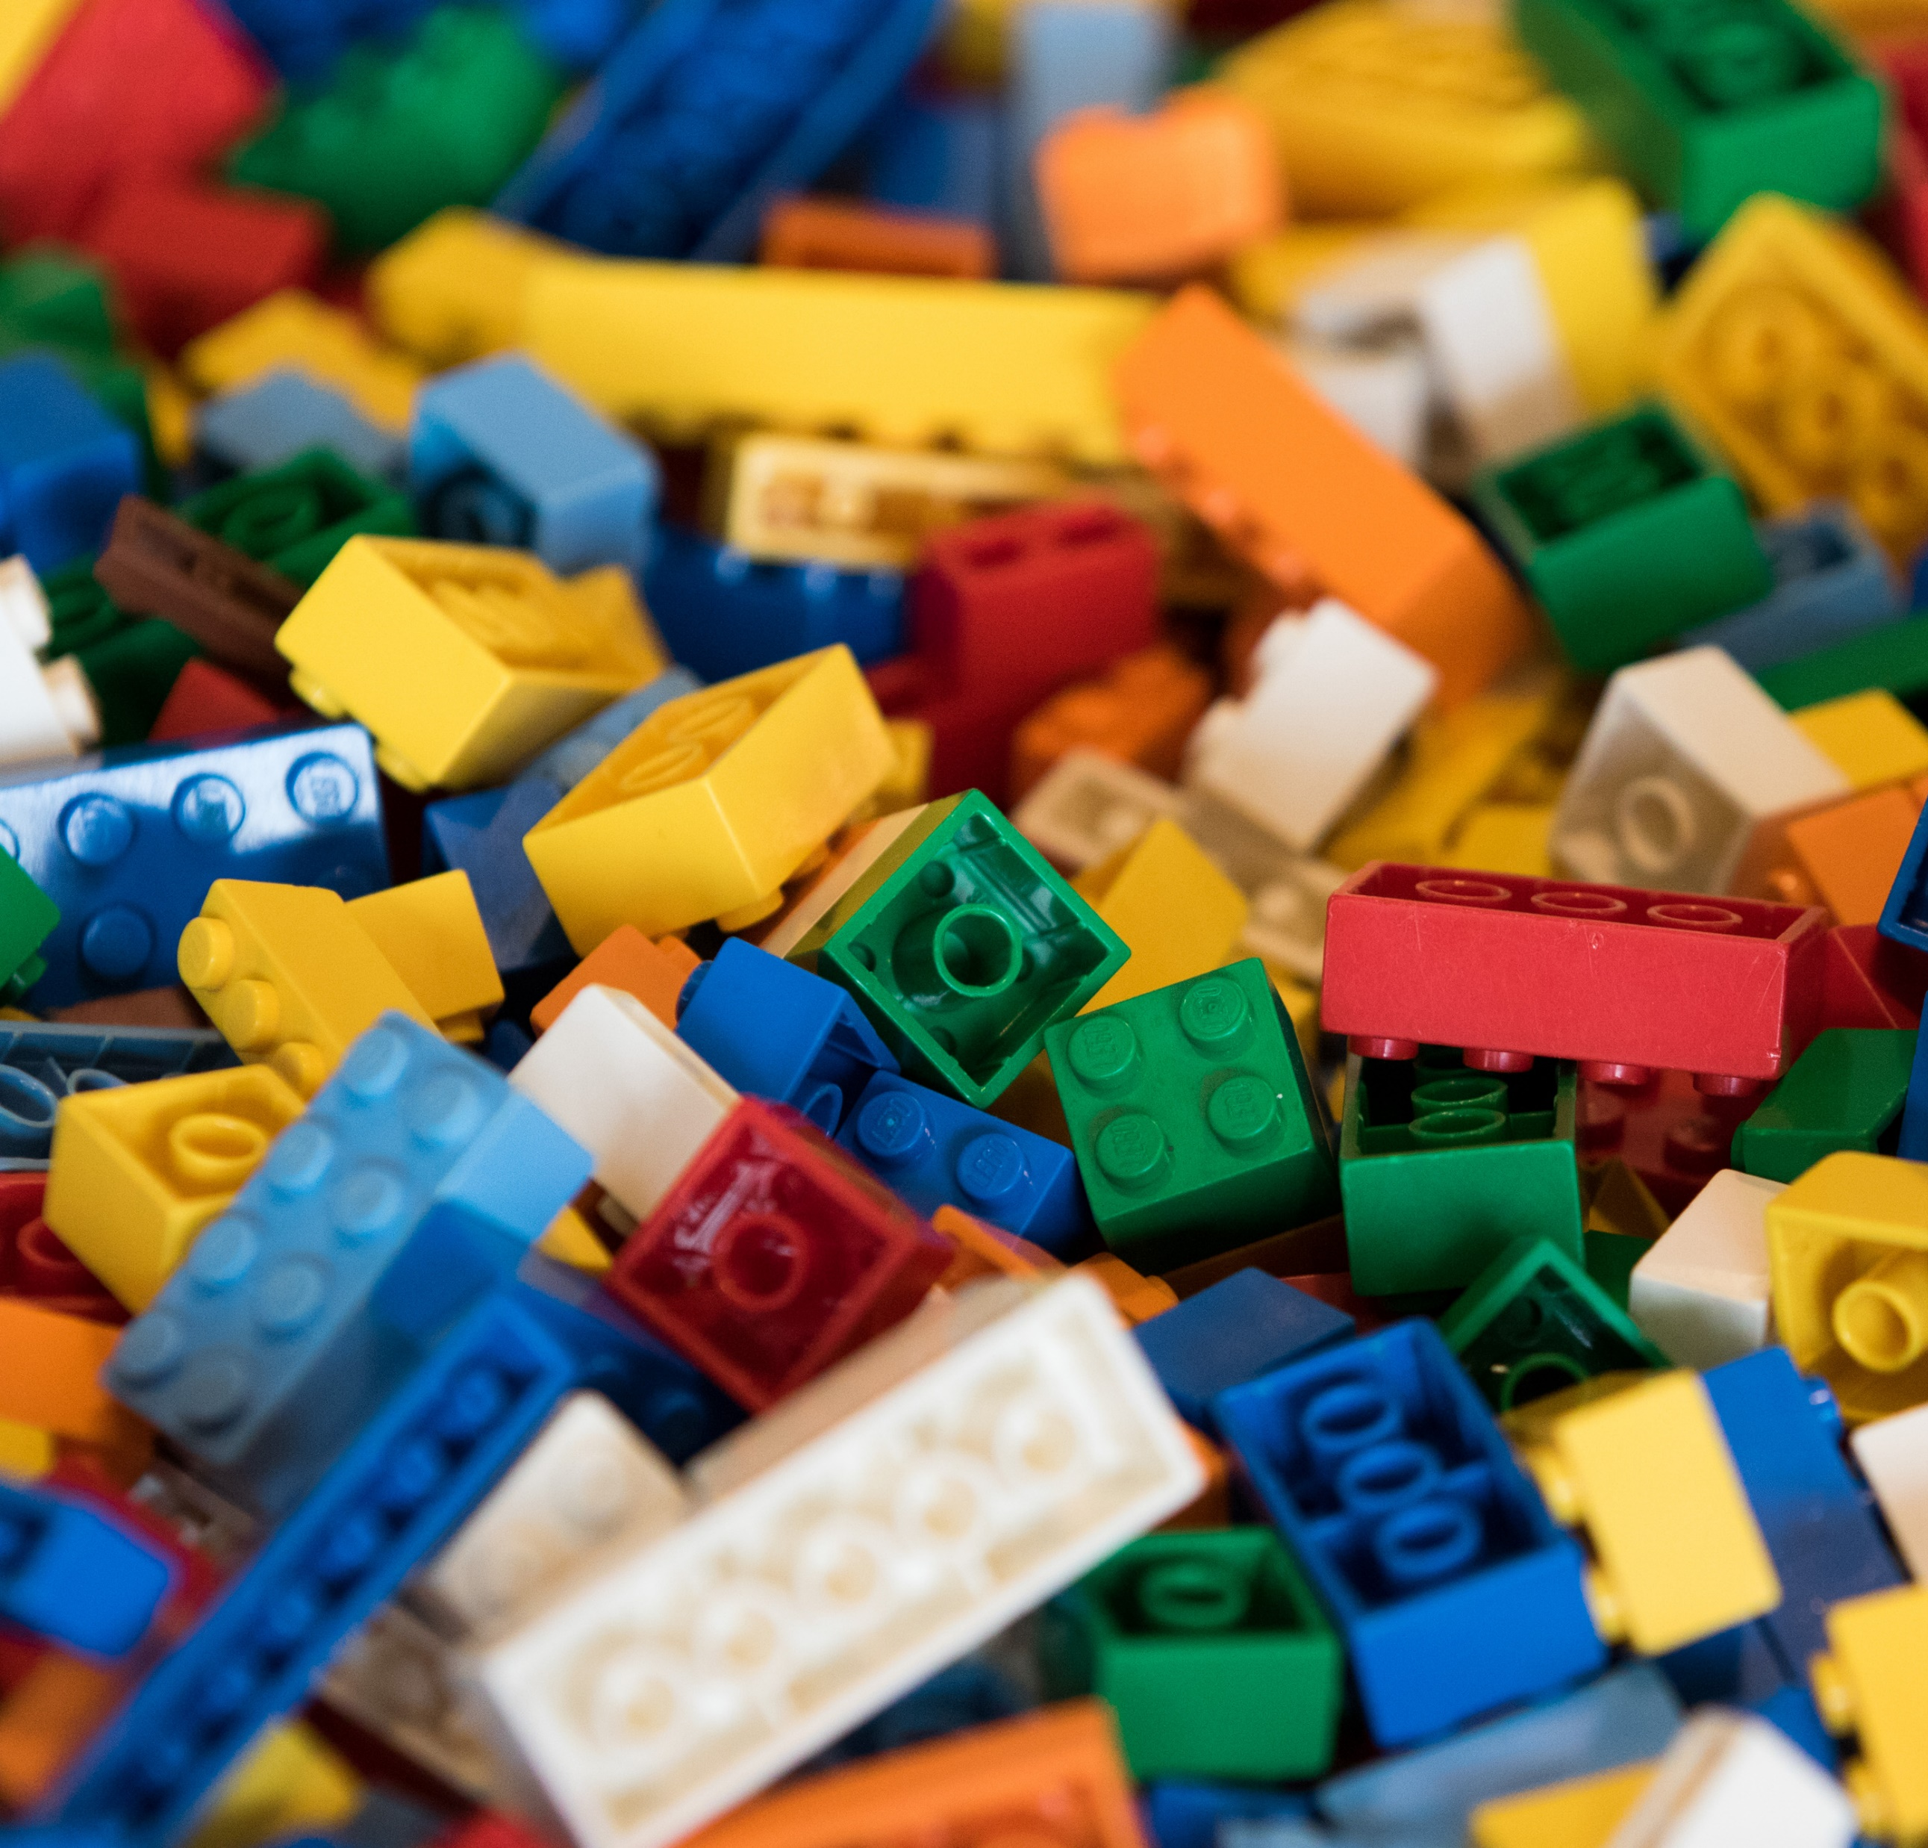
4) THERE ARE SOLUTIONS, AND YOU CAN BE PART OF THEM!
Plastic 101

Slide 66
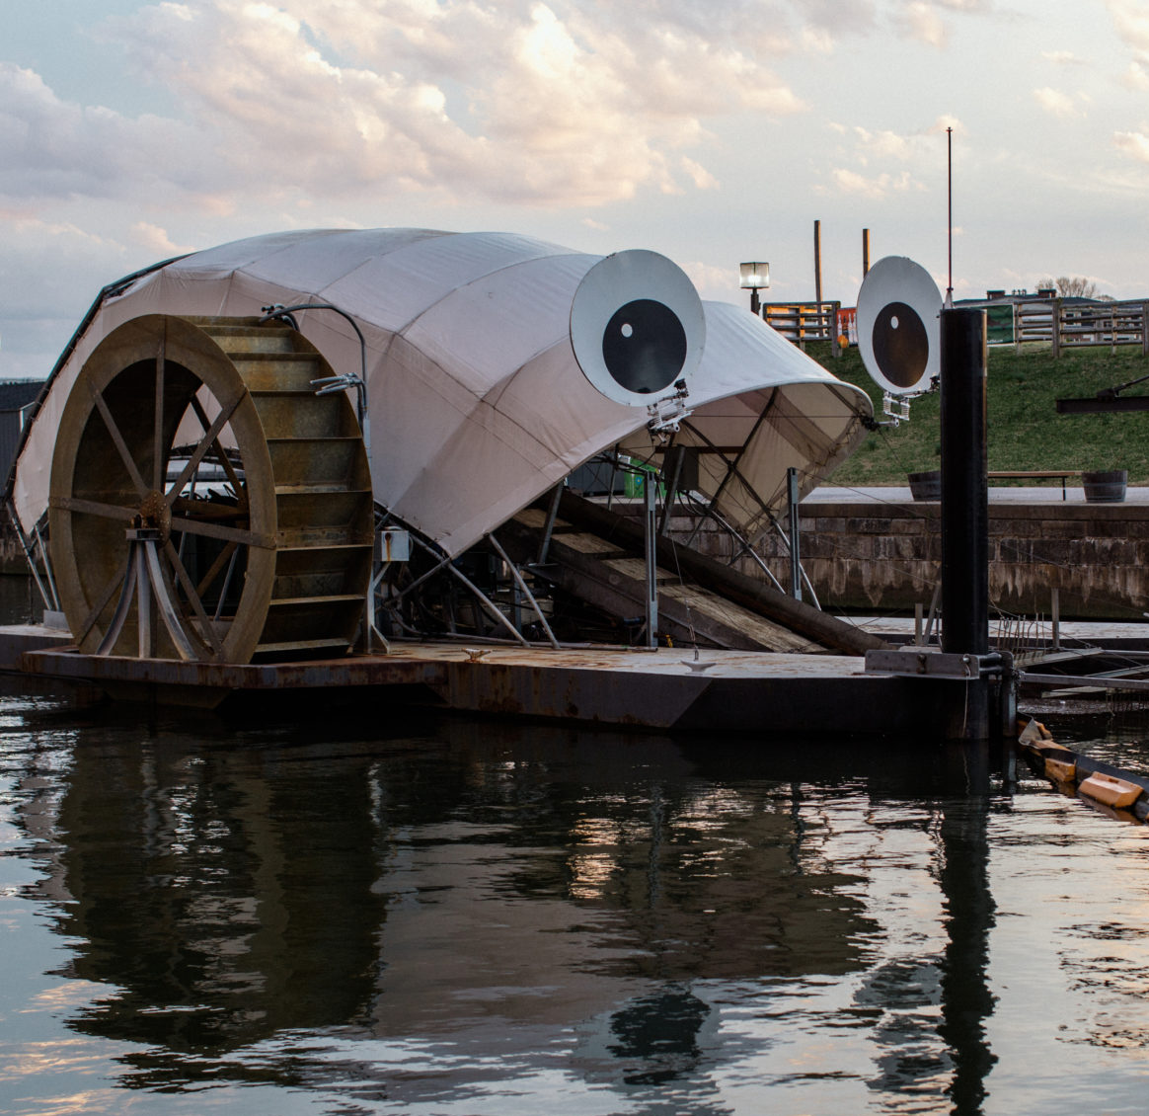
4) THERE ARE SOLUTIONS, AND YOU CAN BE PART OF THEM!
Plastic 101
Large Scale Solutions

Slide 67
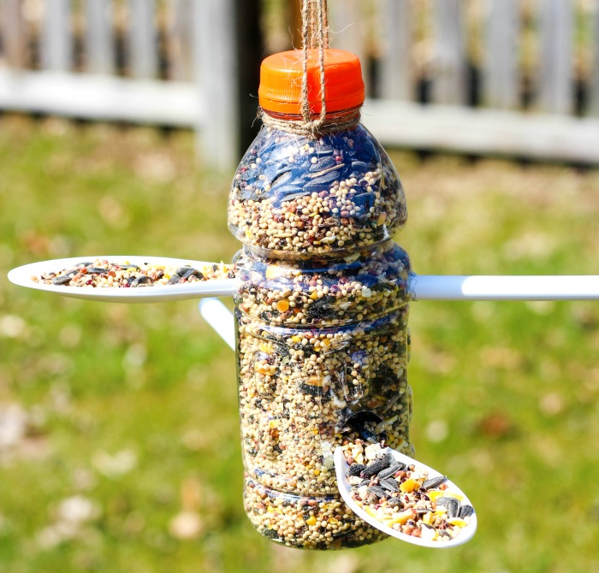
4) THERE ARE SOLUTIONS, AND YOU CAN BE PART OF THEM!
Plastic 101
Large Scale Solutions
Smaller Scale Solutions

Slide 68
PLASTIC 101

Slide 69
PLASTIC 101
Polymer
Natural vs. Synthetic
DNA & Proteins
Build a polymer
Paper clip
Paper chain
Cross Linked Polymer - SLIME
My morning with plastic
What was most surprising?
Ex. How much sheets
Resin Code Hunt
Similarities & Differences
#7 Other
What doesn’t have a code?
Pro’s & Con’s

Slide 70
PLASTIC 101
Polymer
Natural vs. Synthetic
DNA & Proteins
Build a polymer
Paper clip
Paper chain
Cross Linked Polymer - SLIME
My morning with plastic
What was most surprising?
Ex. How much sheets
Resin Code Hunt
Similarities & Differences
#7 Other
What doesn’t have a code?
Pro’s & Con’s

Slide 71
PLASTIC 101
Polymer
Natural vs. Synthetic
DNA & Proteins
Build a polymer
Paper clip
Paper chain
Cross Linked Polymer - SLIME
My morning with plastic
What was most surprising?
Ex. How much sheets
Resin Code Hunt
Similarities & Differences
#7 Other
What doesn’t have a code?
Pro’s & Con’s

Slide 72
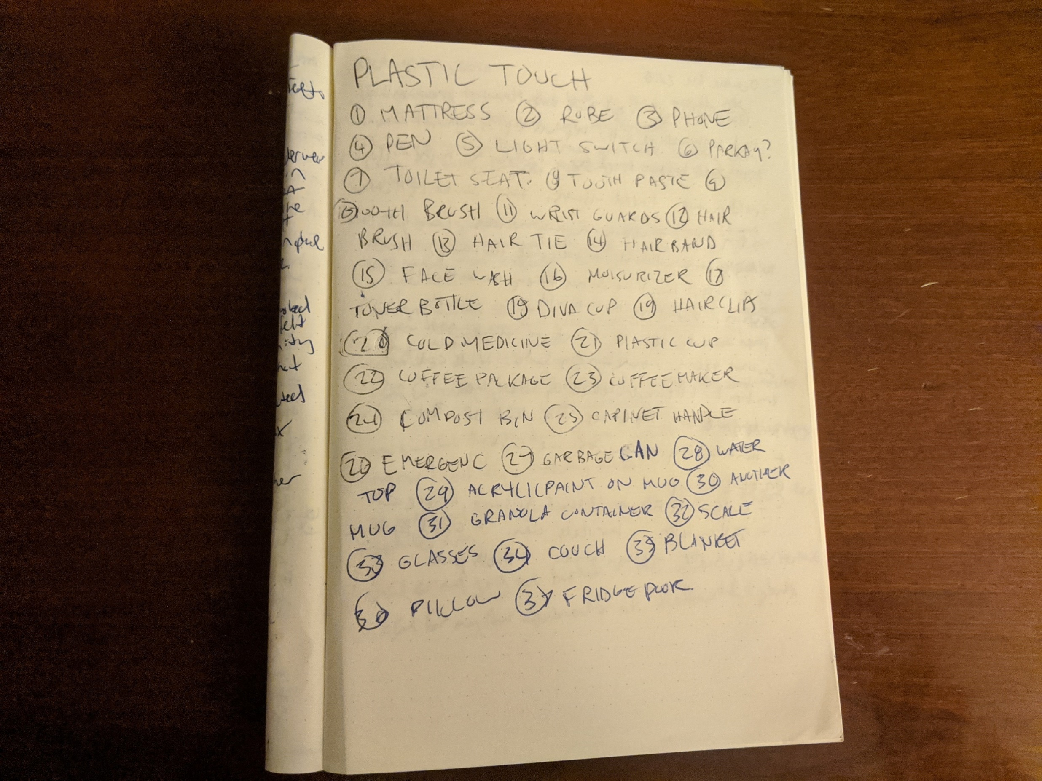
PLASTIC 101
Polymer
Natural vs. Synthetic
DNA & Proteins
Build a polymer
Paper clip
Paper chain
Cross Linked Polymer - SLIME
My morning with plastic
What was most surprising?
Ex. How much sheets
Resin Code Hunt
Similarities & Differences
#7 Other
What doesn’t have a code?
Pro’s & Con’s

Slide 73
PLASTIC 101
Polymer
Natural vs. Synthetic
DNA & Proteins
Build a polymer
Paper clip
Paper chain
Cross Linked Polymer - SLIME
My morning with plastic
What was most surprising?
Ex. How much sheets
Resin Code Hunt
Similarities & Differences
#7 Other
What doesn’t have a code?
Pro’s & Con’s

Slide 74
PLASTIC 101
Polymer
Natural vs. Synthetic
DNA & Proteins
Build a polymer
Paper clip
Paper chain
Cross Linked Polymer - SLIME
My morning with plastic
What was most surprising?
Ex. How much sheets
Resin Code Hunt
Similarities & Differences
#7 Other
What doesn’t have a code?
Pro’s & Con’s

Slide 75
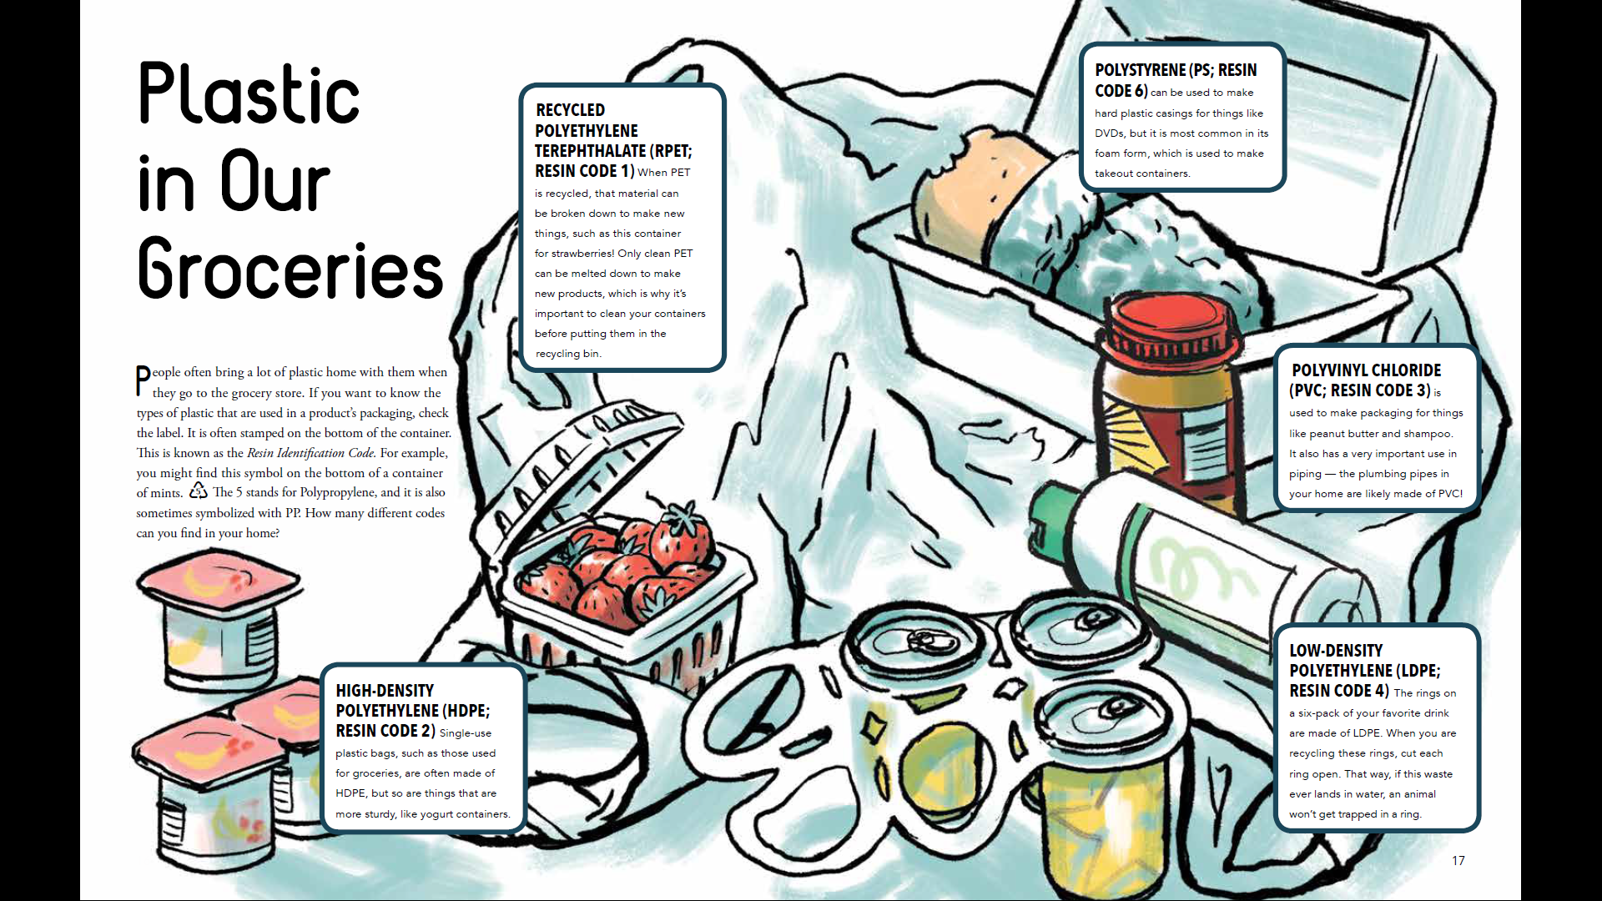
PLASTIC 101
Polymer
Natural vs. Synthetic
DNA & Proteins
Build a polymer
Paper clip
Paper chain
Cross Linked Polymer - SLIME
My morning with plastic
What was most surprising?
Ex. How much sheets
Resin Code Hunt
Similarities & Differences
#7 Other
What doesn’t have a code?
Pro’s & Con’s

Slide 76
LARGE SCALE SOLUTIONS
Notes:
Plastic Reimagined
Corporate Responsibility
Clean-ups

Slide 77
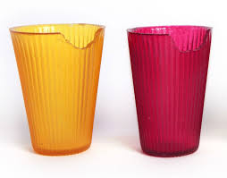
LARGE SCALE SOLUTIONS
Plastic Reimagined
Notes:
Plastic Reimagined
Corporate Responsibility
Clean-ups

Slide 78
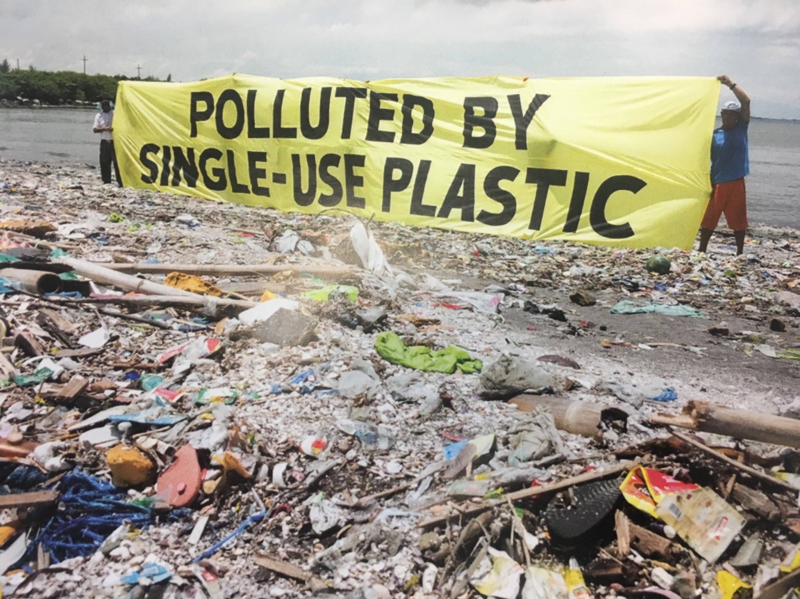
LARGE SCALE SOLUTIONS
Plastic Reimagined
Corporate Responsibility
Notes:
Plastic Reimagined
Corporate Responsibility
Clean-ups

Slide 79
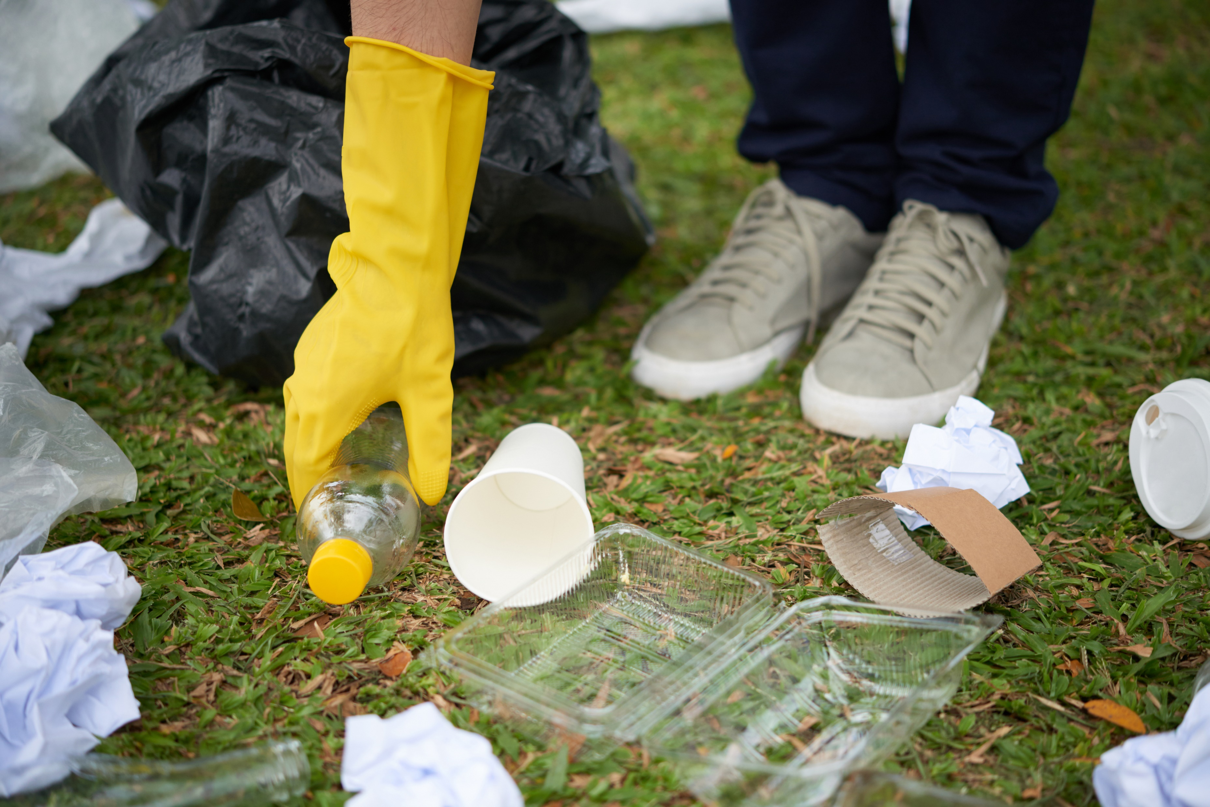
LARGE SCALE SOLUTIONS
Plastic Reimagined
Corporate Responsibility
Clean-ups
Notes:
Plastic Reimagined
Corporate Responsibility
Clean-ups

Slide 80
LARGE SCALE SOLUTIONS
PLASTIC REIMAGINED

Slide 81
LARGE SCALE SOLUTIONS
PLASTIC REIMAGINED
pH
Moisture Oxygen Microorganisms pH Temperature

Slide 82
LARGE SCALE SOLUTIONS
PLASTIC REIMAGINED

Slide 83
LARGE SCALE SOLUTIONS
PLASTIC REIMAGINED

Slide 84
LARGE SCALE SOLUTIONS
PLASTIC REIMAGINED

Slide 85
LARGE SCALE SOLUTIONS
PLASTIC REIMAGINED

Slide 86
LARGE SCALE SOLUTIONS
PLASTIC REIMAGINED

Slide 87
LARGE SCALE SOLUTIONS
PLASTIC REIMAGINED
Project Idea – Water Station Pitch
Around the Bay Race (30K)
~ 10,000 Participants

Slide 88
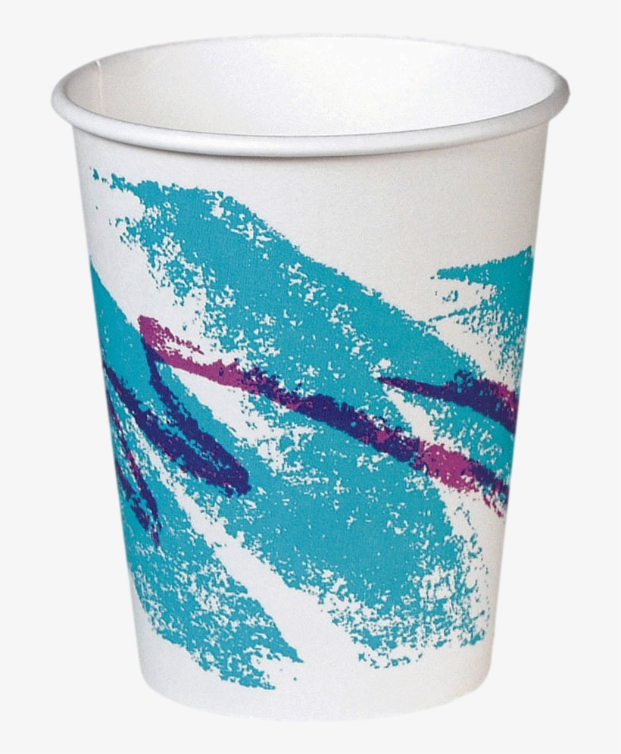
LARGE SCALE SOLUTIONS
PLASTIC REIMAGINED
Project Idea – Water Station Pitch
Around the Bay Race (30K)
~ 10,000 Participants
Water Station every 5K (6 stations)
= 60,000 cups headed to the landfill

Slide 89
LARGE SCALE SOLUTIONS
PLASTIC REIMAGINED
Project Idea – Water Station Pitch
Around the Bay Race (30K)
~ 10,000 Participants
Water Station every 5K (6 stations)
= 60,000 cups headed to the landfill
Hidden Plastic

Slide 90
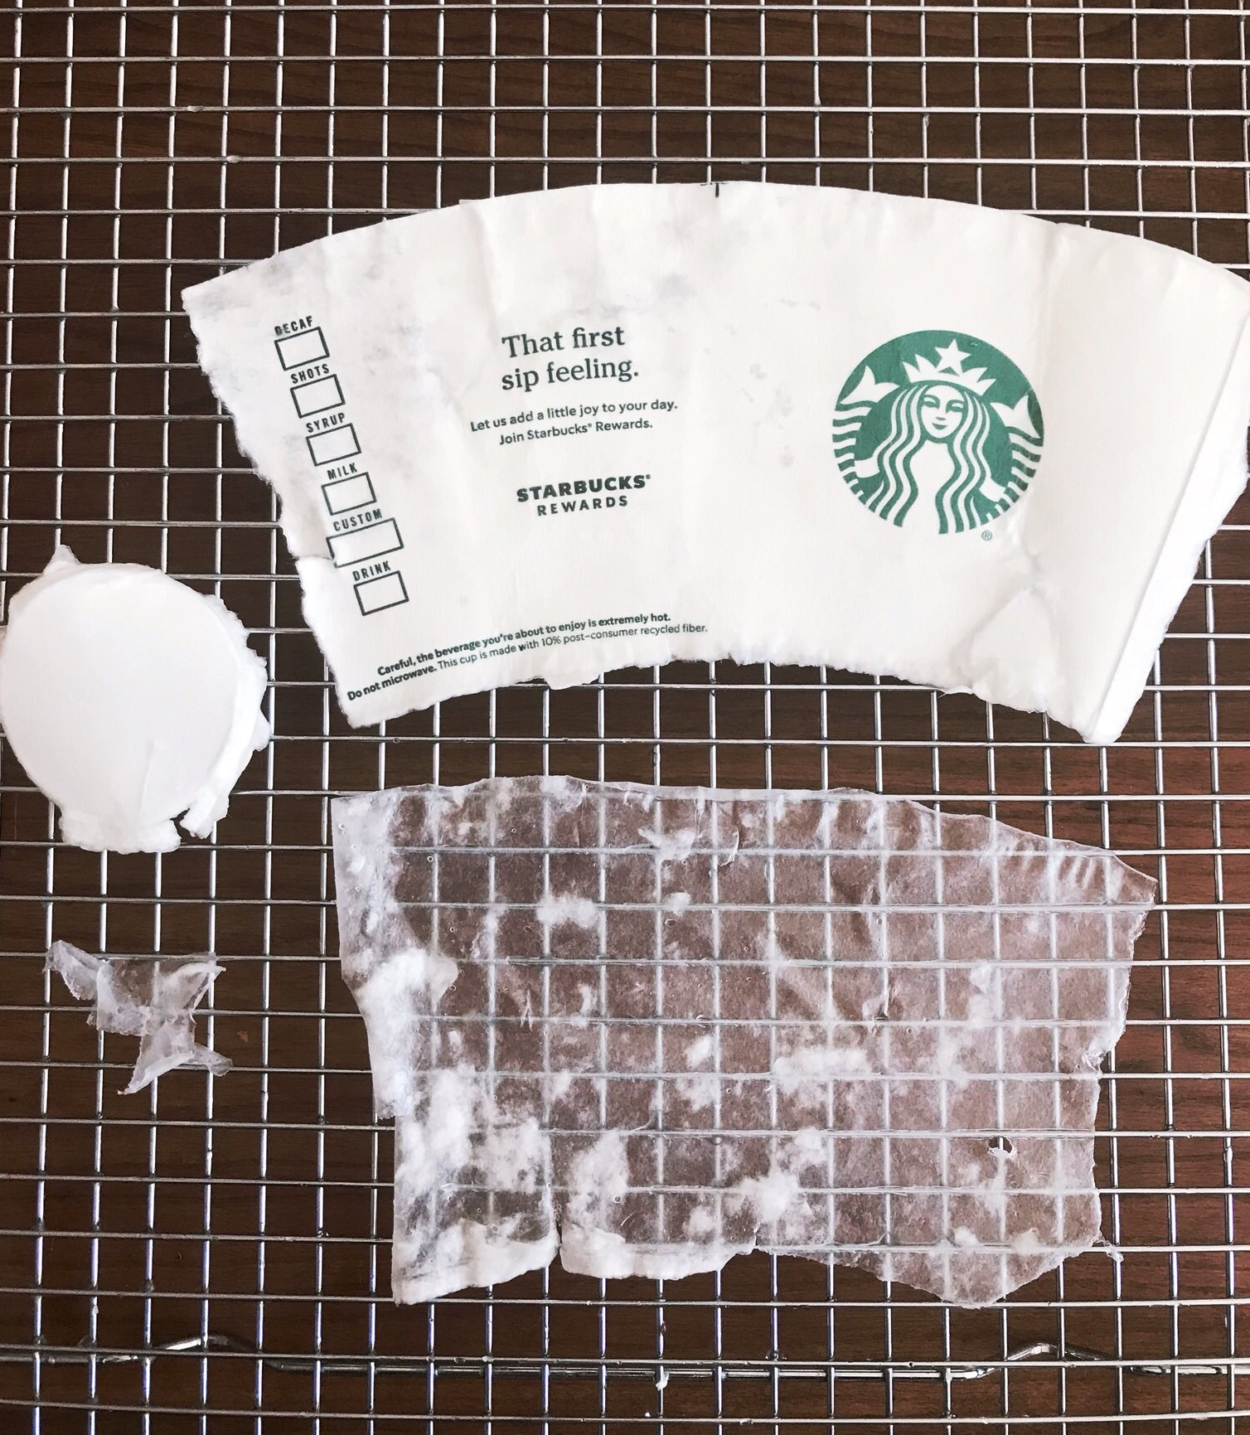
LARGE SCALE SOLUTIONS
PLASTIC REIMAGINED
Project Idea – Water Station Pitch
Around the Bay Race (30K)
~ 10,000 Participants
Water Station every 5K (6 stations)
= 60,000 cups headed to the landfill
Hidden Plastic

Slide 91
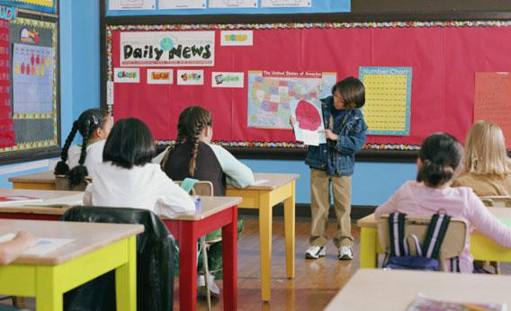
LARGE SCALE SOLUTIONS
PLASTIC REIMAGINED
Project Idea – Water Station Pitch
Around the Bay Race (30K)
~ 10,000 Participants
Water Station every 5K (6 stations)
= 60,000 cups headed to the landfill
Hidden Plastic
Design Challenge
Pitch Your Idea
To the Mayor
CEO of the Race
Environmental Board

Slide 92
LARGE SCALE SOLUTIONS
CORPORATE RESPONSIBILITY

Slide 93
LARGE SCALE SOLUTIONS
CORPORATE RESPONSIBILITY
Individuals
Notes:
Where one study found that 100 energy companies are responsible for 71% of all industrial emissions

Slide 94
LARGE SCALE SOLUTIONS
CORPORATE RESPONSIBILITY
Corporations
Individuals
Notes:
Where one study found that 100 energy companies are responsible for 71% of all industrial emissions

Slide 95
LARGE SCALE SOLUTIONS
CORPORATE RESPONSIBILITY
71%
of all industrial emissions
Corporations
100 energy companies
Source: Carbons Major Report 2017
Individuals
Notes:
Where one study found that 100 energy companies are responsible for 71% of all industrial emissions

Slide 96
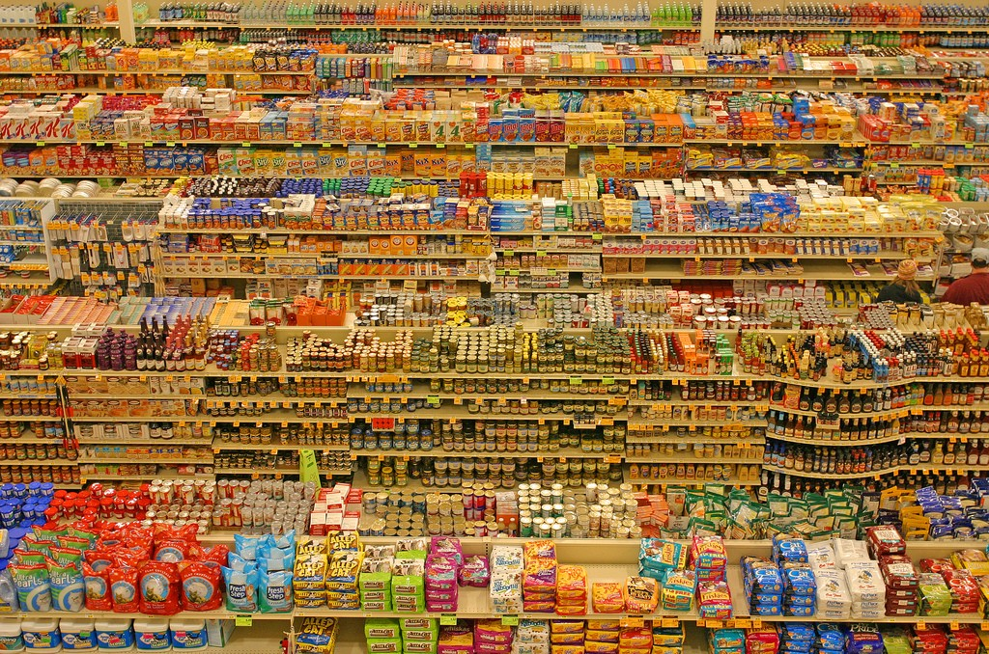
Notes:
Individuals all have a responsibility to care about the health of our planet. But it’s very difficult for individual behaviour to be modified when infrastructure looks like this. And so one of the biggest hings we can do as individuals is use our voice to help hold power to account. Some examples include:

Slide 97
LARGE SCALE SOLUTIONS
CORPORATE RESPONSIBILITY
Lesson Idea
How are brands contributing to the global trash pile?

Slide 98
LARGE SCALE SOLUTIONS
CORPORATE RESPONSIBILITY
Lesson Idea
How are brands contributing to the global trash pile?

Slide 99
LARGE SCALE SOLUTIONS
CORPORATE RESPONSIBILITY
Lesson Idea
How are brands contributing to the global trash pile?
Marketing analysis
What is Green Washing?

Slide 100
LARGE SCALE SOLUTIONS
CORPORATE RESPONSIBILITY
Lesson Idea
How are brands contributing to the global trash pile?
Marketing analysis
What is Green Washing?
How can an ad shift responsibility?

Slide 101
LARGE SCALE SOLUTIONS
CORPORATE RESPONSIBILITY
Lesson Idea
How are brands contributing to the global trash pile?
Marketing analysis
What is Green Washing?
How can an ad shift responsibility?

Slide 102
LARGE SCALE SOLUTIONS
CORPORATE RESPONSIBILITY
Lesson Idea
How are brands contributing to the global trash pile?
Marketing analysis
What is Green Washing?
How can an ad shift responsibility?
History of plastic lobbying groups
Notes:
The Keep America Beautiful campaign featured the “Crying
Indian” Iron Eyes Cody — played by a non-Native American
actor — famously shedding a single tear in response to a
polluted landscape.
We can all agree that litter is a bad thing, but did
you know that anti-litter campaigns might not
have the most innocent of origins? The 1950s saw
a meteoric rise in consumerism in part from the
ease and affordability of plastic, but this increase
also meant a lot more pollution. With public pressure,
legislatures began to consider regulations
that would require manufacturers, especially the
packaging industry, to be held accountable and
make less junk in the first place.
These changes could have had a drastic impact
on profits, but packaging companies lobbied hard
against these policies. As a means to shift responsibility
and clean up their images, packaging industry
leaders, including Coca Cola and the Dixie Cup
Company, came together to devise a plan. The
result was “Keep America Beautiful,” a massive
media campaign that targeted bad environmental
practices — but of individuals not businesses.
This campaign essentially flipped the script and
steered the blame toward individual litterbugs
as the main culprits of the garbage problem.
This campaign worked in favor of manufacturers.
Today there are several anti-littering laws for individuals
across America, but there are minimal laws
that regulate the packaging industry.

Slide 103
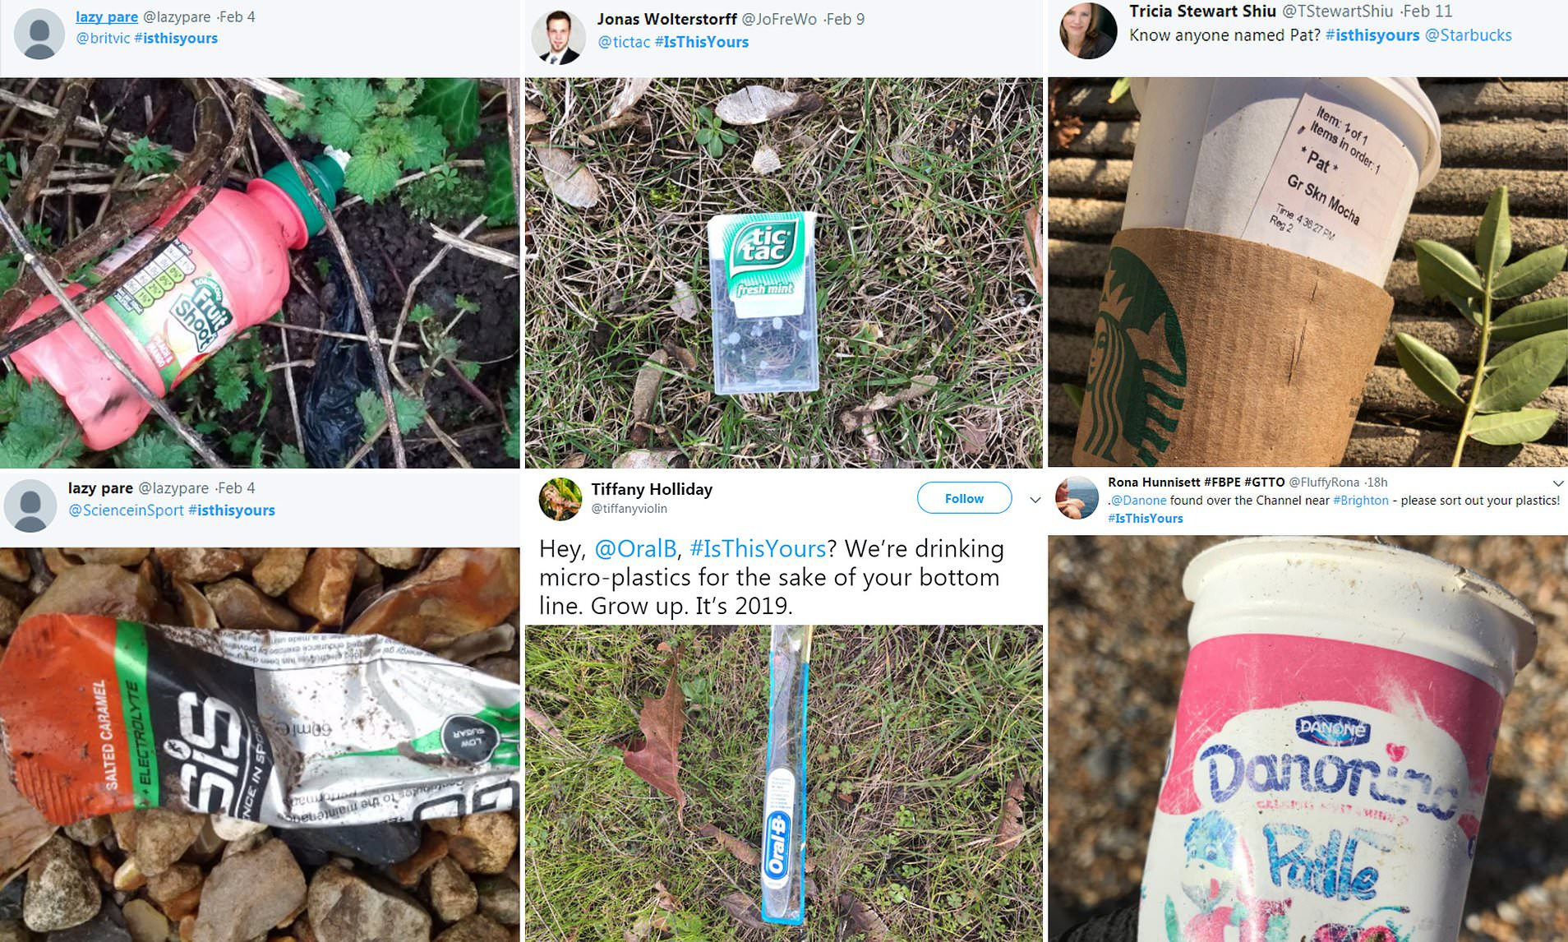
LARGE SCALE SOLUTIONS
CORPORATE RESPONSIBILITY
Lesson Idea
How are brands contributing to the global trash pile?
Marketing analysis
What is Green Washing?
How can an ad shift responsibility?
History of plastic lobbying groups
Holding power to account
Notes:
The Keep America Beautiful campaign featured the “Crying
Indian” Iron Eyes Cody — played by a non-Native American
actor — famously shedding a single tear in response to a
polluted landscape.
We can all agree that litter is a bad thing, but did
you know that anti-litter campaigns might not
have the most innocent of origins? The 1950s saw
a meteoric rise in consumerism in part from the
ease and affordability of plastic, but this increase
also meant a lot more pollution. With public pressure,
legislatures began to consider regulations
that would require manufacturers, especially the
packaging industry, to be held accountable and
make less junk in the first place.
These changes could have had a drastic impact
on profits, but packaging companies lobbied hard
against these policies. As a means to shift responsibility
and clean up their images, packaging industry
leaders, including Coca Cola and the Dixie Cup
Company, came together to devise a plan. The
result was “Keep America Beautiful,” a massive
media campaign that targeted bad environmental
practices — but of individuals not businesses.
This campaign essentially flipped the script and
steered the blame toward individual litterbugs
as the main culprits of the garbage problem.
This campaign worked in favor of manufacturers.
Today there are several anti-littering laws for individuals
across America, but there are minimal laws
that regulate the packaging industry.

Slide 104
LARGE SCALE SOLUTIONS
CLEAN-UPS
The Ocean Cleanup
Mr. Trash Wheel
Seabins
Great Canadian Shoreline Cleanup

Slide 105
LARGE SCALE SOLUTIONS
CLEAN-UPS
The Ocean Cleanup
Mr. Trash Wheel
Seabins
Great Canadian Shoreline Cleanup

Slide 106
LARGE SCALE SOLUTIONS
CLEAN-UPS
The Ocean Cleanup
Mr. Trash Wheel
Seabins
Great Canadian Shoreline Cleanup

Slide 107
LARGE SCALE SOLUTIONS
CLEAN-UPS
The Ocean Cleanup
Mr. Trash Wheel
Seabins
Great Canadian Shoreline Cleanup

Slide 108
LARGE SCALE SOLUTIONS
CLEAN-UPS
The Ocean Cleanup
Mr. Trash Wheel
Seabins
Great Canadian Shoreline Cleanup

Slide 109
LARGE SCALE SOLUTIONS
CLEAN-UPS
The Ocean Cleanup
Mr. Trash Wheel
Seabins
Great Canadian Shoreline Cleanup

Slide 110
LARGE SCALE SOLUTIONS
CLEAN-UPS
The Ocean Cleanup
Mr. Trash Wheel
Seabins
Great Canadian Shoreline Cleanup

Slide 111
LARGE SCALE SOLUTIONS
CLEAN-UPS
Great Canadian Shoreline Cleanup

Slide 112
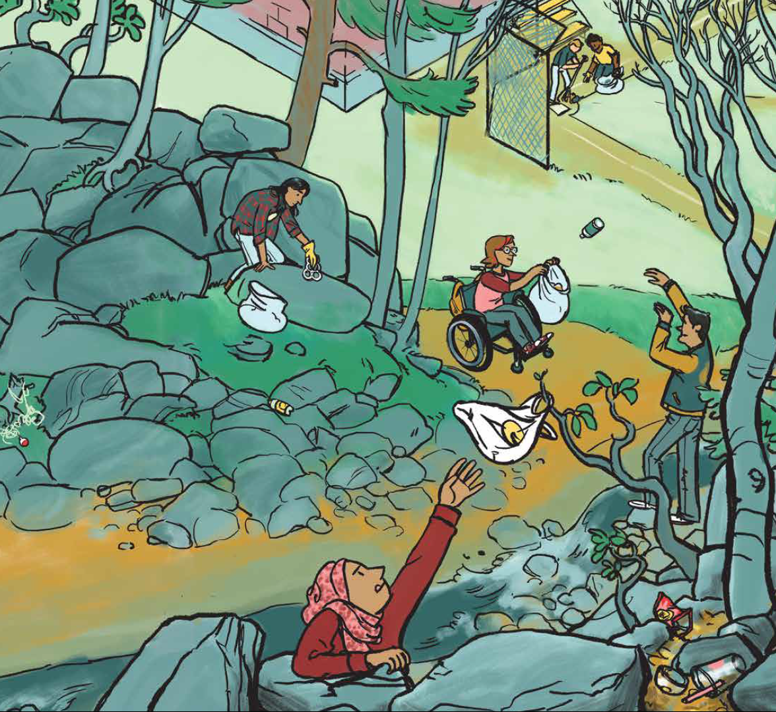
LARGE SCALE SOLUTIONS
CLEAN-UPS
Great Canadian Shoreline Cleanup
Can be done with social distance

Slide 113
LARGE SCALE SOLUTIONS
CLEAN-UPS
Great Canadian Shoreline Cleanup
Can be done with social distance
Consult Guidelines

Slide 114
LARGE SCALE SOLUTIONS
CLEAN-UPS
Great Canadian Shoreline Cleanup
Can be done with social distance
Consult Guidelines
Document what you found

Slide 115
SMALL SCALE SOLUTIONS
MEASURE → MANAGE
PLASTIC WASTE AUDIT
Item | Number per week | Number Per Year
Straws
Bags
Coffee Pod
Cup
Takeout container
Clamshell of produce

Slide 116
SMALL SCALE SOLUTIONS
MEASURE → MANAGE
PLASTIC WASTE AUDIT
Item | Number per week | Number Per Year
Straws | 2
Bags | 3
Coffee Pod | 6
Cup | 1
Takeout container | 2
Clamshell of produce | 5

Slide 117
SMALL SCALE SOLUTIONS
MEASURE → MANAGE
PLASTIC WASTE AUDIT
Item | Number per week | Number Per Year
Straws | 2 | 104
Bags | 3 | 156
Coffee Pod | 6 | 312
Cup | 1 | 52
Takeout container | 2 | 104
Clamshell of produce | 5 | 260

Slide 118
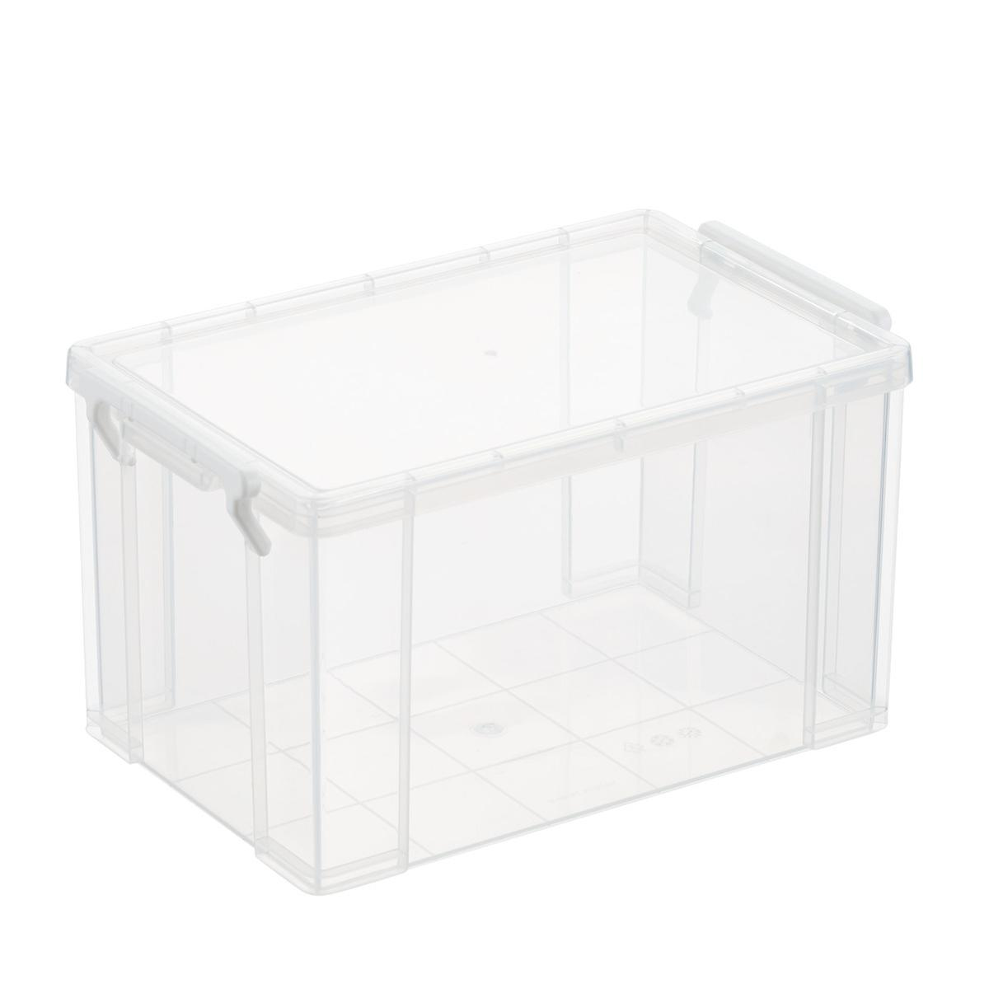
SMALL SCALE SOLUTIONS
MEASURE → MANAGE
Volume and Weight
PLASTIC WASTE AUDIT

Slide 119
SMALL SCALE SOLUTIONS
MEASURE → MANAGE
Volume and Weight
PLASTIC WASTE AUDIT

Slide 120
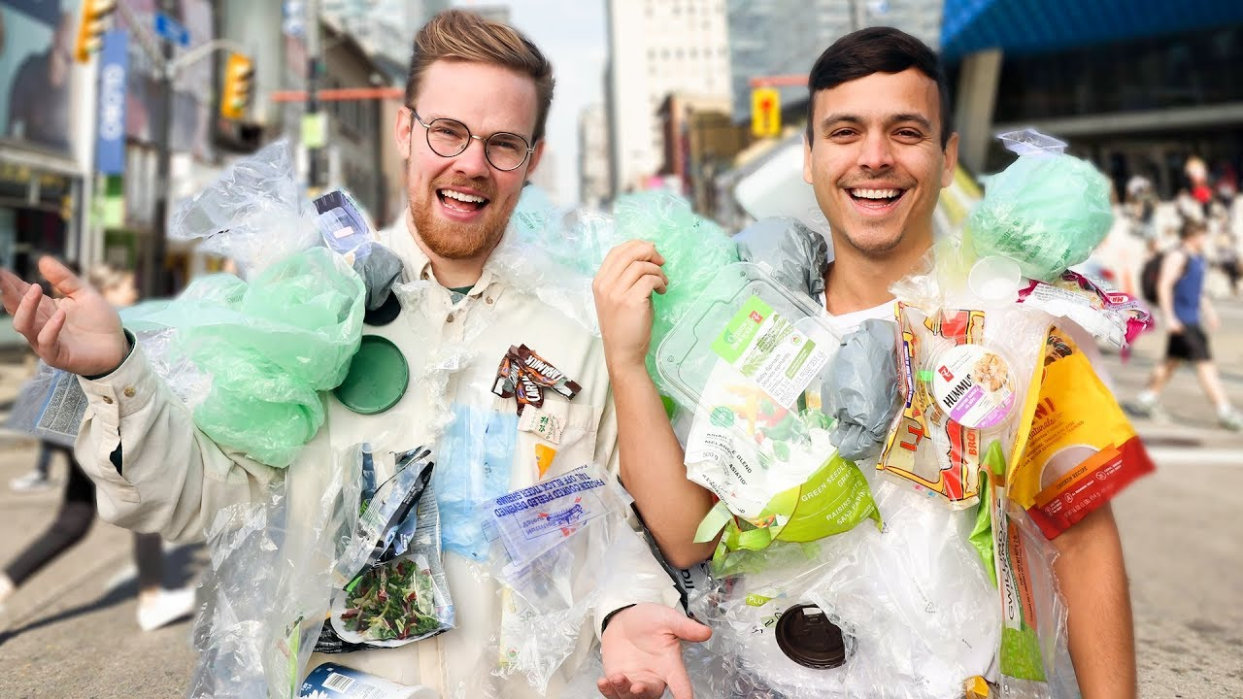
SMALL SCALE SOLUTIONS
MEASURE → MANAGE
Wear Your Waste
PLASTIC WASTE AUDIT

Slide 121
SMALL SCALE SOLUTIONS

Slide 122
3Rs
SMALL SCALE SOLUTIONS
6Rs
Notes:
What can we do? It feels like such a huge problem but the good news there is a lot of positive change that can happen. There are significant actions that can be taken by businesses and governments – however! I want to focus on the things each and everyone of us can do right now.

Slide 123
3Rs
SMALL SCALE SOLUTIONS
6Rs
Reduce
Reuse
Recycle
Rethink
Repair
Refuse
Notes:
What can we do? It feels like such a huge problem but the good news there is a lot of positive change that can happen. There are significant actions that can be taken by businesses and governments – however! I want to focus on the things each and everyone of us can do right now.

Slide 124
3Rs
SMALL SCALE SOLUTIONS
6Rs
Reduce
Reuse
Recycle
Rethink
Repair
Refuse
Notes:
What can we do? It feels like such a huge problem but the good news there is a lot of positive change that can happen. There are significant actions that can be taken by businesses and governments – however! I want to focus on the things each and everyone of us can do right now.

Slide 125
SMALL SCALE SOLUTIONS
Artist Shady Rabab has been teaching kids how to turn plastic bottles into amazing
musical instruments.
Notes:
Artist Shady Rabab has been teaching kids how to turn plastic bottles into amazing
musical instruments.

Slide 126
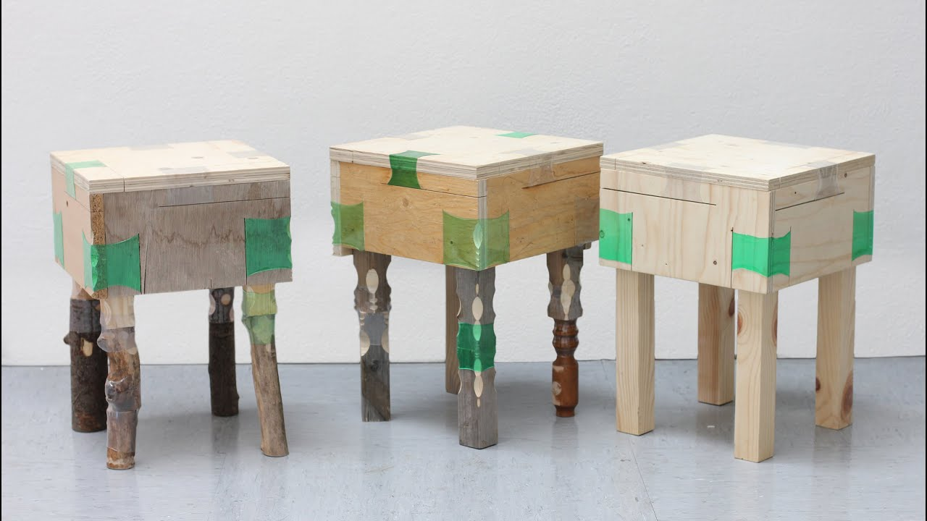
SMALL SCALE SOLUTIONS
Notes:
Designer Micaella Pedros is making furniture using scrap wood and plastic bottles
found as litter. By heating the plastic around two pieces of wood, it forms an extra strong and stable joint.

Slide 127
SMALL SCALE SOLUTIONS

Slide 128
SMALL SCALE SOLUTIONS
Precious Plastic

Slide 129
SMALL SCALE SOLUTIONS
Precious Plastic

Slide 130
SMALL SCALE SOLUTIONS
WHAT CAN YOU DO WITH A YOGURT TUB?

Slide 131
SMALL SCALE SOLUTIONS
WHAT CAN YOU DO WITH A YOGURT TUB?

Slide 132
SMALL SCALE SOLUTIONS
WHAT CAN YOU DO WITH A YOGURT TUB?

Slide 133
SMALL SCALE SOLUTIONS
WHAT CAN YOU DO WITH A YOGURT TUB?

Slide 134
SMALL SCALE SOLUTIONS
WHAT CAN YOU DO WITH A YOGURT TUB?

Slide 135
SMALL SCALE SOLUTIONS
WHAT CAN YOU DO WITH A YOGURT TUB?

Slide 136
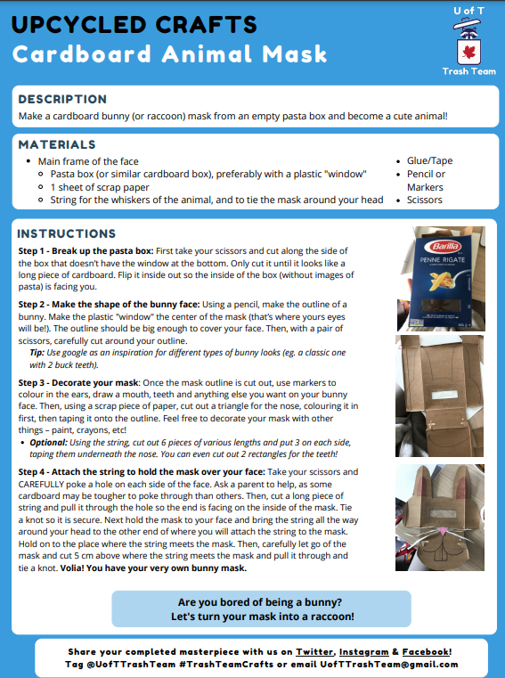
SMALL SCALE SOLUTIONS
U of T Trash Team

Slide 137
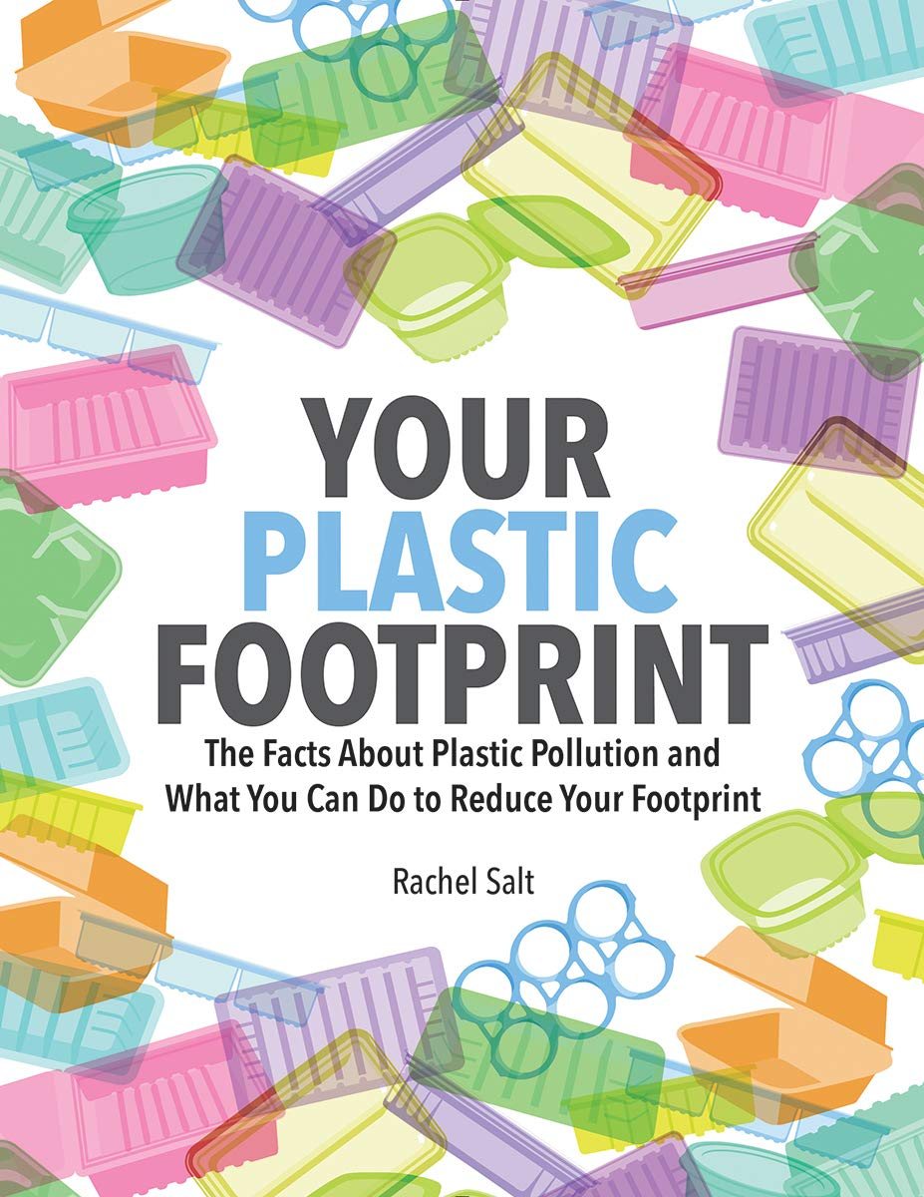

Slide 138
